Slide 1


COS30008 Data Structures and Patterns Recursion, Linked Lists

Slide 2
Recursion
If a procedure contains within its body calls to itself, then this procedure is said to be recursively defined.
This approach of program specification is called recursion and is found not only in programming.
If we the define a procedure recursively, then there must exist at least one sub-problem that can be solved directly, that is without calling the procedure again.
A recursively defined procedure must always contain a directly solvable sub-problem. Otherwise, this procedure does not terminate. This condition that is used to stop the recursion is called the base case.

Slide 3
Problem-Solving with Recursion
Recursion is an important problem-solving technique in which a given problem is reduced to smaller instances of the same problem.
The general structure of a recursive definition is
X = ... X ...
left hand side
right hand
side

Slide 4
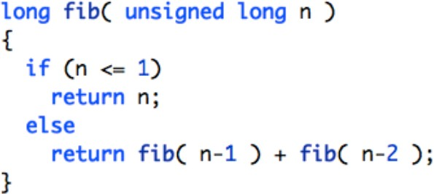
Fibonacci
The Fibonacci numbers are the following sequence of
numbers: 0, 1, 1, 2, 3, 5, 8, 13, 21, 34, 55, 89, …
In mathematical terms, the sequence F(n) of Fibonacci numbers is defined recursively as follows:
F(0) = 0
F(1) = 1
F(n) = F(n-1) + F(n-2)

Slide 5
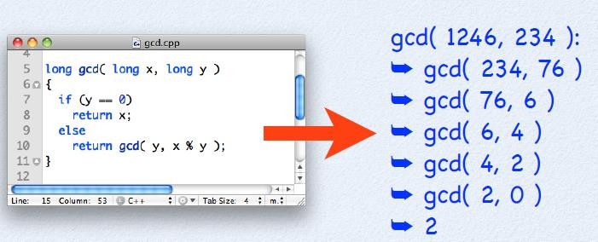
Tail-Recursive
Tail recursion is a form of linear recursion. In tail recursion, the recursive call is the last operation the function does.
int pow(int a, int b)
{
if (b==1) return a; else
return a * pow(a, b-1);
}

Slide 6
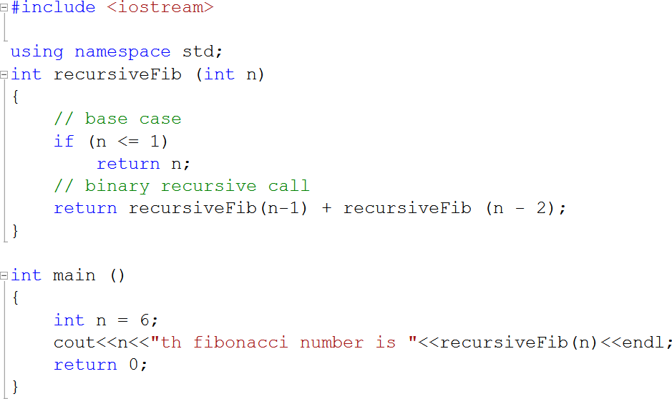
Other type of Recursion
Binary recursion
Some recursive functions don't just have one call to themselves, they have two (or more). Functions with two recursive calls are referred to as binary recursive functions.
E.g. Fibonacci sequence: By definition, the first two numbers in the Fibonacci sequence are 0 and 1, and each subsequent number is the sum of the previous two

Slide 7
Towers of Hanoi
Problem:
Move disks from a start peg to a target peg using a middle peg.
Challenge:
All disks have a unique size and at no time must a bigger disk be placed on top of a smaller one.

Slide 8
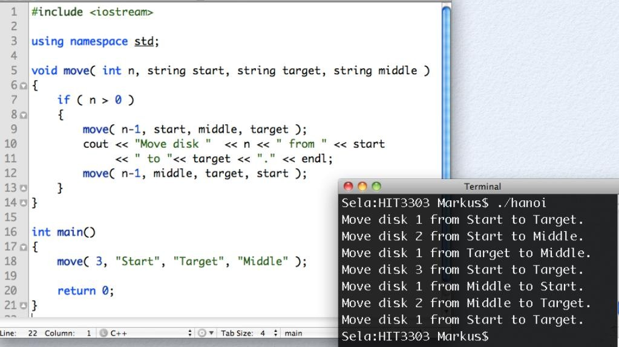
The Recursive Procedure

Slide 9
Recursive Problem-Solving: Factorials
The factorial for positive integers is
n! = n * (n - 1) * … * 1
The recursive definition:
1 if n = 0
n! =
n* (n-1)! if n > 0

Slide 10
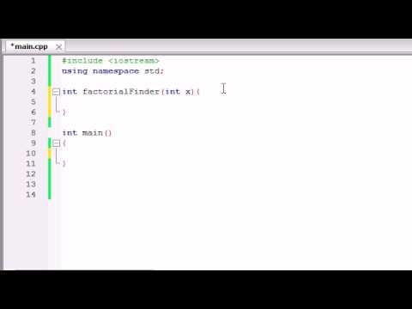
Recursion in C++
URL: https://www.youtube.com/watch?v=4agL-MQq05E

Slide 11
Why?
Recursion is an important concept that can be used for linked lists!

Slide 12
Problems with Arrays
An array is a contiguous storage that provides insufficient abstractions for handling insertion and deletion of elements.
Insertion and deletion require n/2 shifts on average.
The computation time is O(n).
Resizing affects performance.

Slide 13
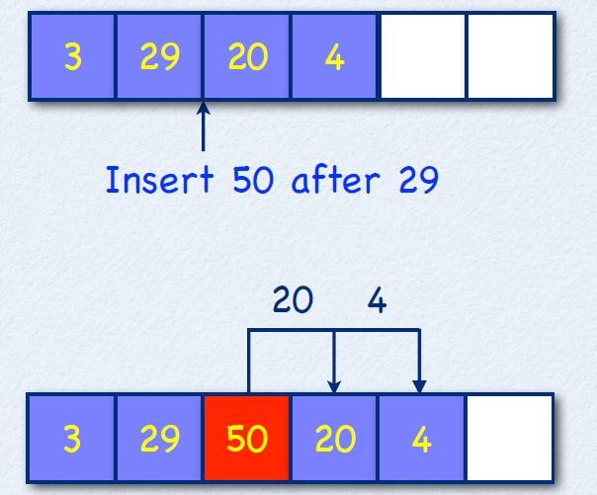
Insertion Requires Relocation

Slide 14
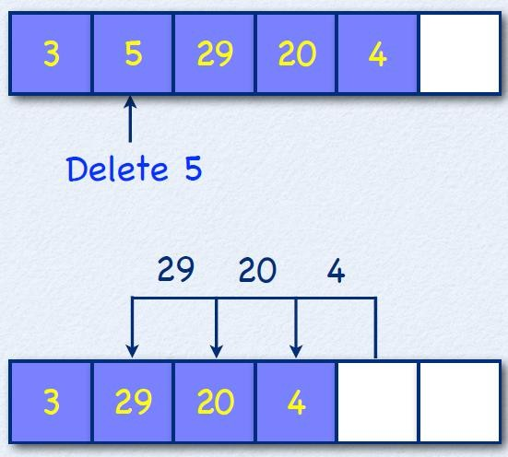
Deletion Requires Relocation

Slide 15
Singly-Linked Lists
A singly-linked list is a sequence of data items, each connected to the next by a pointer called next.
A data item may be a primitive type, a composite type, or even another pointer.
A singly-linked list is a recursive data structure whose nodes refers to nodes of the same type.

Slide 16
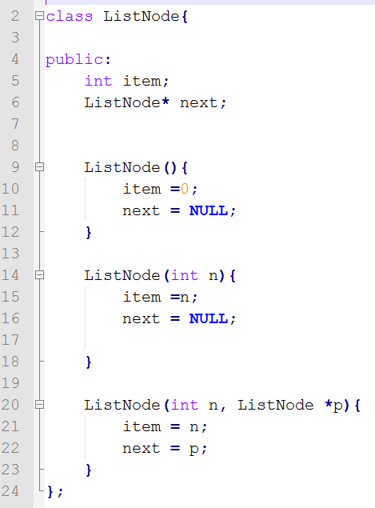
List Nodes
A list manages a collection of elements.
The class ListNode defines a value-based sequence container for values of type int.

Slide 17
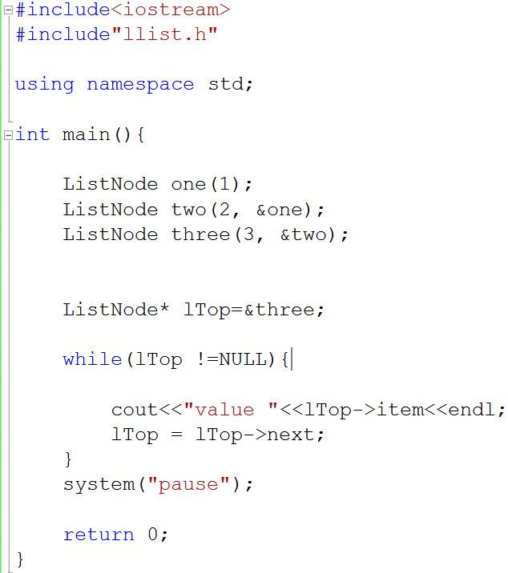
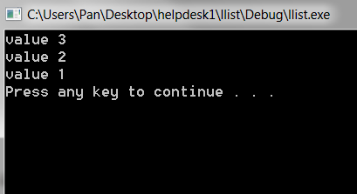
A Simple List of Integers

Slide 18
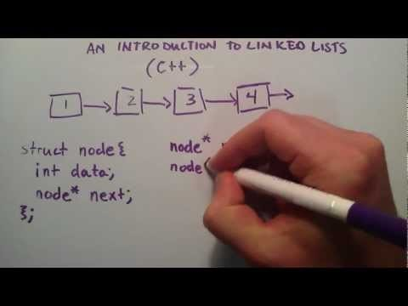
Introduction to Linked Lists
URL: https://www.youtube.com/watch?v=o5wJkJJpKtM

Slide 19
Aliasing
In programming, two variables are aliased, if the refer to the same entity (aka object).
If two variables are aliased, then any changes to one variable also effects the other.
Aliasing can be avoided by using the value-based object model in C++: Every object is unique.
In languages that rely solely on the reference-based object model (e.g., Java) are prone to aliasing. To avoid it, one needs to clone objects.

Slide 20
Reference
C++ supports three forms of member variables:
values, references, and pointers.
The use of references and pointers prevents copying the underlying object. But
References are aliases to objects that have to reside in a fixed and unique location as long the reference is active (i.e., in use). Creating references to parameters passed as actual values to a member function can violate the uniqueness criterion for locations of references.
Objects referenced by pointers can denote both values located on the heap and values located on the stack. Without additional information, we cannot distinguish these cases, which can lead to memory leaks.

Slide 21
Difference between Stack and Heap
Both Stack and Heap are stored in the Computer’s RAM (Random Access Memory)
Stack – Is for static memory allocation
When an object is created inside a function without using the “new” operator, the object will be created and stored on the Stack. When the function ends, the object is destroyed as it goes out of scope and will be deleted from the memory.
Heap – Is for dynamic memory allocation
When an object is created inside a function using the “new” keyword, the object will be created on the Heap. Data on the heap will remain there until it is manually deleted by the programmer which may result in a memory leak.
Reference URL: https://www.programmerinterview.com/index.php/data-structures/difference-between-stack-and-heap/

Slide 22
Templates
Templates are blueprints from which classes and/or functions automatically generated by the compiler based on a set of parameters.
Each time a template is used with different parameters is used, a new version of the class or function is generated.
A new version of a class or function is called specialization of the template.

Slide 23
Function overloading
Function overloading is a programming concept that allows programmers to define two or more functions with the same name. Each function has a unique signature.. Note that they have different return values and parameters
int max( int a, int b)
{return a<b?b:a;}
double max(double a, double b)
{ return a<b?b:a}

Slide 24
Function template
“Type substitutes”
template <class T> T max(T a, T b)
{ return a<b ? b:a;}
The symbol T is called a type parameter. It is simply a place holder that is replaced by an actual type or class when the function is invoked.

Slide 25
Template header
A function template is declared in the same way as an ordinary function, except that it is preceded by the specification
template <class T>
The type parameter T may be used in place of ordinary types within the function definition
The word class is used to mean a class or primitive type.
A template may have several type parameters, specified like this:
template<class T, class U, class V>

Slide 26
Call a template function
Template functions are called the same way ordinary function are called.
int m = 22 int n=66
int max_value; max_value=max(m, n);

Slide 27
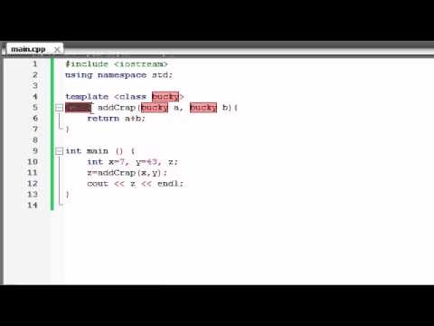
Function Templates
URL: https://www.youtube.com/watch?v=W0aoAm6eYSk

Slide 28
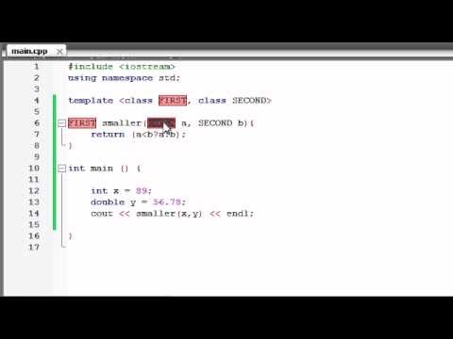
Function Templates with Multiple Parameters
URL: https://www.youtube.com/watch?v=SeleR7PDs5Q

Slide 29
What will happen?
template <class T>
T max(T a, T b)
{return a < b ? b : a;}
int main(){
long m =2;
double n= 4.12;
cout << max(m,n)
<< endl;
}
Would this compile?
It will not. Because the template function expects arguments of the same data type. ‘m’ is long while ‘n’ is double.

Slide 30
What will happen?
template <class T, class U>
T max(T a, U b)
{return (a < b ? b : a);}
int main(){
long m =2;
double n= 4.12;
cout << max(m,n)
<< endl;
}
Would this compile?
Yes it will. The template here is able to handle arguments of 2 different data types.
Output
Output will be 4. As the output will follow the data type of the first parameter, m.

Slide 31
Class template
Class template work the same way as a function template except that it generates classes instead of function. The general syntax is
template<class T, ...> class X{...}
As with function templates, a class template may have several template parameters. Some of them can be primitive types parameters
template<class T, int n, class U> class X{...}

Slide 32
Primitive types must be constant
Template are instantiated at compile time, values passed to the primitive types must be constant
template<class T, int n> class X{ .. }
int main()
{
X<float, 22> a1;
const int n =44;
X<char, n> a2
int m=66;
X<short, m>a3
}
Class templates are also known as parameterised types.
//error (int m is not const)

Slide 33
More on class template
The member function of a class template are themselves function templates with the same template header as their class
template<class T> class mathFunc{
static T square(T t){return t*t}
};
is handled in the same way that following template function would be handled
template<class T>
T square(T t){return t*t}

Slide 34
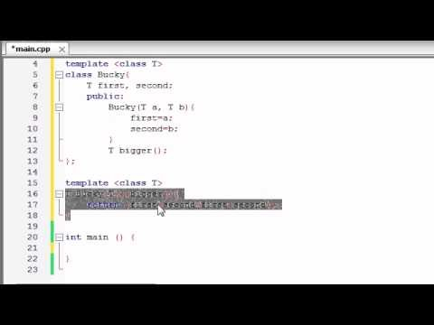
Class Templates
URL: https://www.youtube.com/watch?v=U2QvTsMvWmM

Slide 35
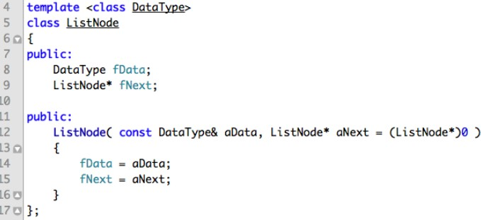
Node Class template

Slide 36
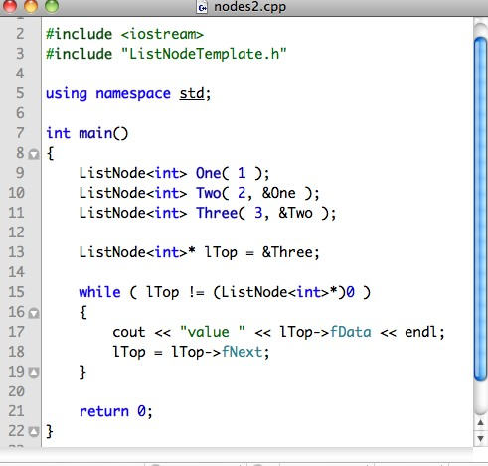
The New Main

Slide 37
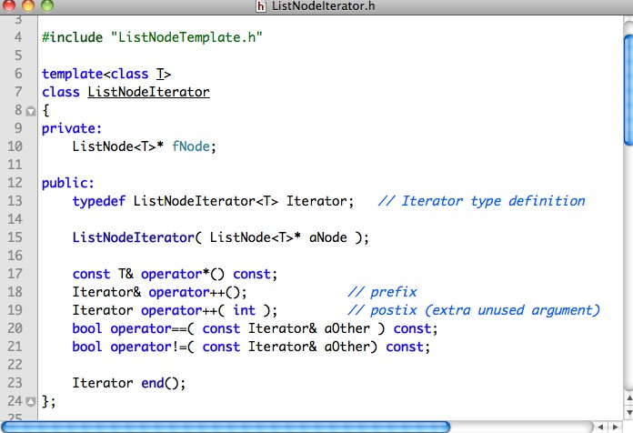
Node Iterator

Slide 38
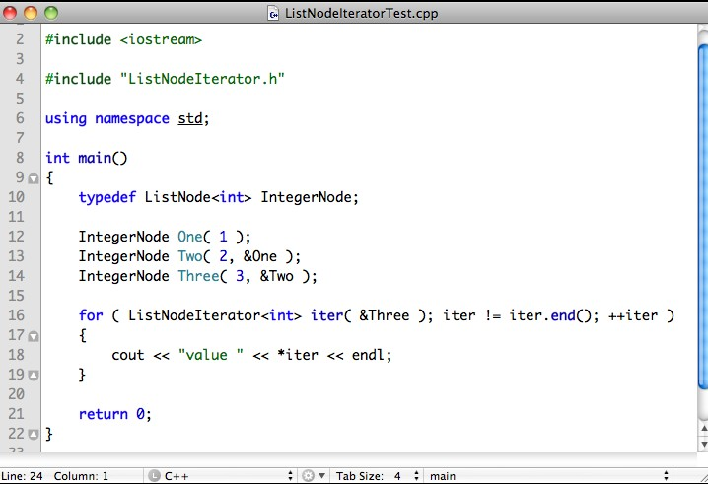
Node Iterator Test

Slide 39
The Need for Pointers
A linked-list is a dynamic data structure with a varying number of nodes.
Access to a linked-list is through a pointer variable in which the base type is the same as the node
type:
ListNode<int>* pListOfInteger = (ListNode<int>*)0;
Here (ListNode<int>*)0 stands for Nil.

Slide 40

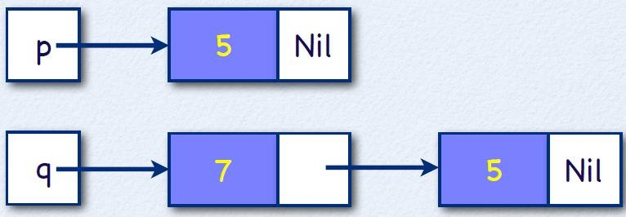

Node Construction
IntegerNode *p, *q;
p = new IntegerNode( | 5 | );
q = new IntegerNode( | 7, | p );

Slide 41
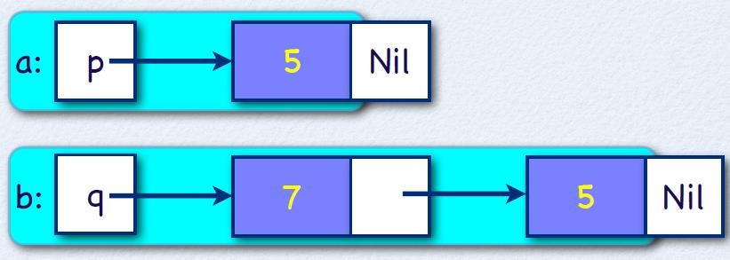
Node Content Access
int a = p->fData;
int b = q->fNext->fData;

Slide 42
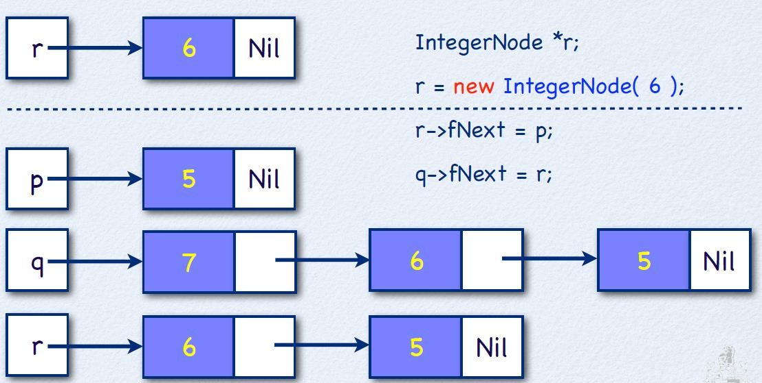
Inserting a Node

Slide 43
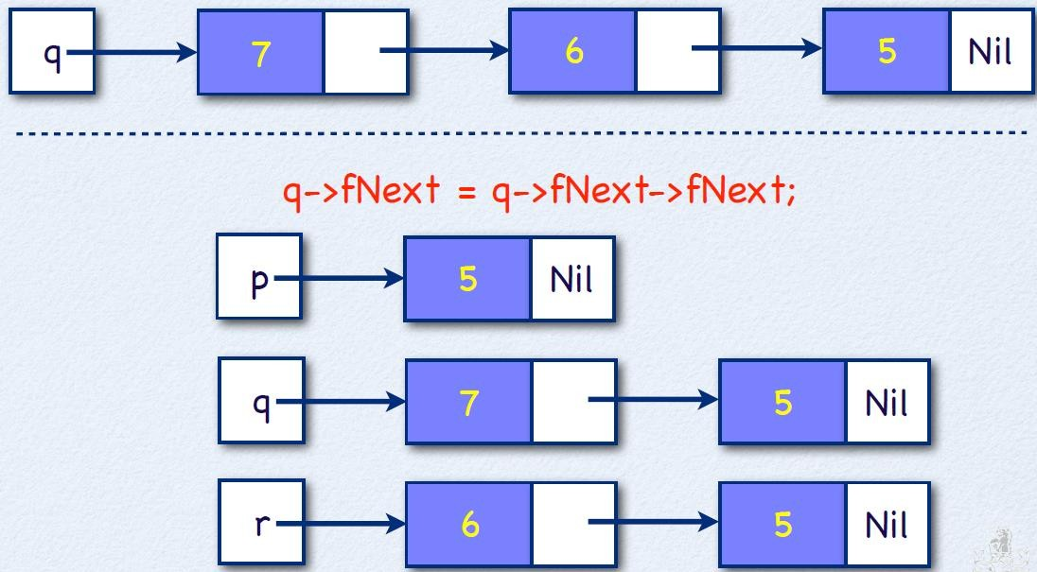
Deleting a Node

Slide 44
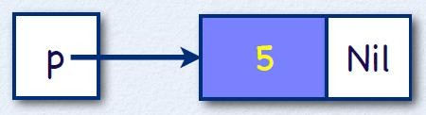

Insert at the Top(at the end)
IntegerNode *p = (IntegerNode*)0;
p = new IntegerNode( 5, p );
p = new IntegerNode( 7, p );

Slide 45
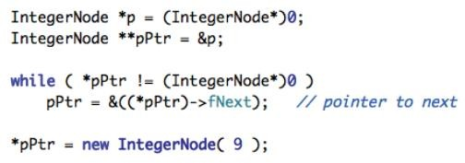
Insert at the Beginning
To insert a new node at the beginning of a linked list we need to search for the beginning:

Slide 46
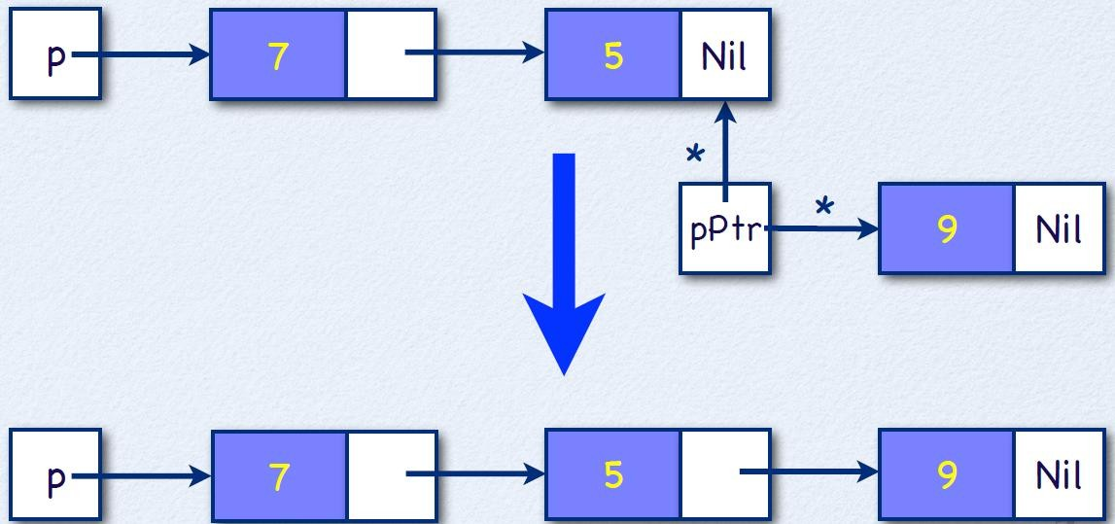
Insert at the Beginning

Slide 47
End of Recursions and Linked List

